Slide 1

Spoiled Beverage Detector
Vanessa Mathew , Bahar Rahmani
Kymbat Talant , Jahangir Esfandiari
Solution Design in Medical Engineering
Medical Systems Engineering

Slide 2

Overview
Introduction
Biochemistry of Beverages
Current Technology
Functions & structures
Possible designs
Gas sensor
PH meter
Final design
Outlook

Slide 3
Introduction
Consumption of spoiled drinks
Lack of awareness of early signs of expired drinks
Stomach cramp, fever, vomiting, nausea, diarrhea
Suspicious cases of beverage spoilage
Discarding
Boiling & cooling down (e.g. milk)
Waste of food, energy & time

Slide 4

Introduction
Objective
Development of a device for fast detection of spoiled drinks & report of results

Slide 5
Biochemistry
PH range of beverages
Juices | pH range | Mean
Orange | 4.19 - 4.50 | 4.34
Sweet lime | 4.70 - 5.47 | 5.08
Carrot | 5.76 - 6.03 | 5.89
Milk | 6.6-6.8 | 6.7
Table1: PH level of different drinks [1]

Slide 6
Biochemistry
Spoiled beverage microorganisms
Microorganisms in spoiled beverage
Yeasts
Bacteria
Molds
Mycotoxins
Pathogens

Slide 7


Current technologies
Media cup
Representing content information (e.g. temperature)
Components
sensors
Microprocessor
capacitors
Infrared network
Software
Fig.1. Media cup Prototypes,
Gellersen et al. International Symposium on Handheld and Ubiquitous Computing (1999)

Slide 8
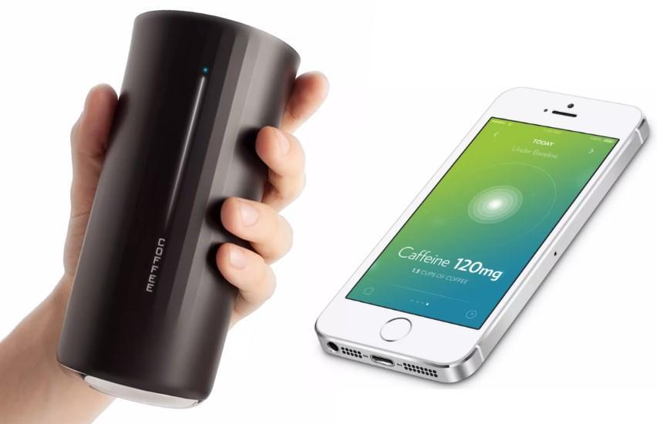
Current technologies
Vessyl
Detecting amount & type of beverage
Information displayed on side of cup
Mobile App to track every sip
Indication of sufficient hydration by blue light
Fig.2. Vessyl smart cup,
http://hiconsumption.com/2014/06/vessyl-smart-cup/

Slide 9
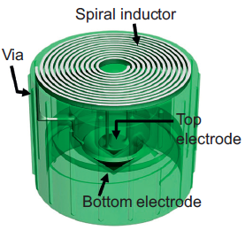
Current technologies
Smart cap
Sensing quality of liquid in fluidic package
Based on changes in capacitance
Resonance frequency shifts of the LC tank via an inductive reader
LC tank as wireless-resonant sensor
Passive operation without power consumption
Fig.3. Design of a wireless “smart cap”, [5]

Slide 10
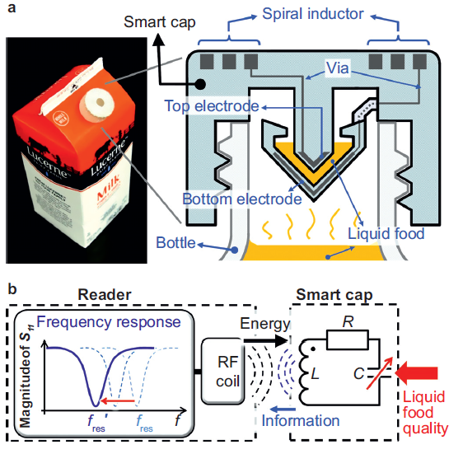
Current technologies
Smart cap
Fig.4. (a) smart cap with milk package (b) LC resonant circuit, [5]

Slide 11
Why Milk?
Selection of 1 type of drink to detect – Pasturized Milk
Easier to detect spoiled milk than spoiled juices
Spoiled juices have a wide range of pH value between different fruits
Health issues in third world countries
Human senses are often inadequate
Important nutrients for humans as wells as for animals

Slide 12
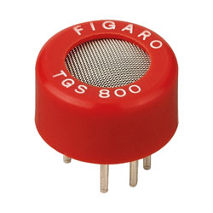
Possible designs
Gas sensor
Use of a gas sensor TGS 800
Closed measuring chamber
Power Supply
Voltmeter
Fig.5. TGS 800 sensor,
https://ciiva.com/part/tgs-800-13645760

Slide 13
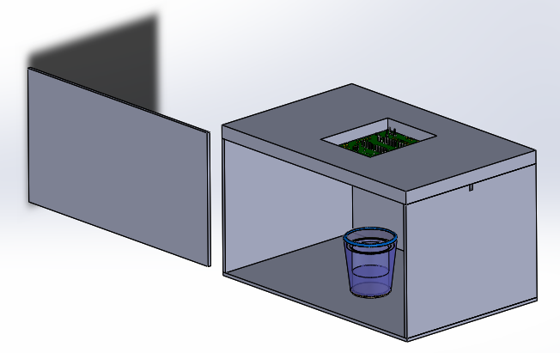
Possible designs
Gas sensor
Fig.6. Enclosed Glass Box Drawing, done by Solid Works

Slide 14


Possible designs
Gas sensor
Gas Sensors
Hole for Wiring
Polymer
Glass
Spoiled Milk
Fig.7. Enclosed Glass Box Drawing, done by Solid Works

Slide 15
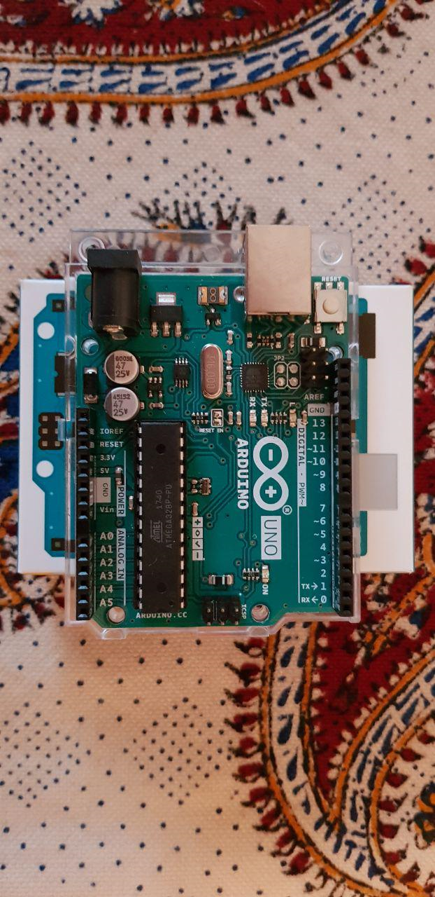
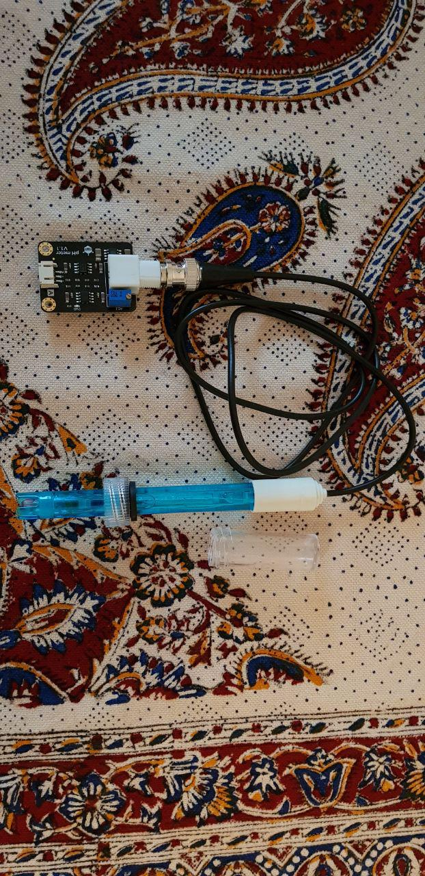
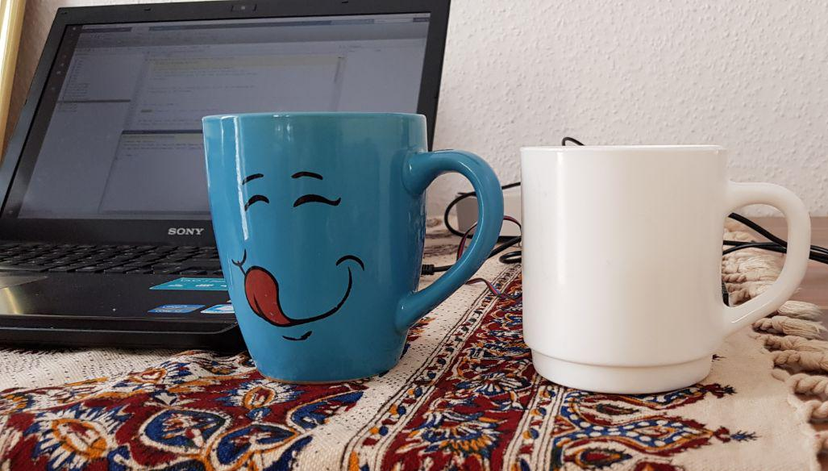


Final design
Rduino Microcontroller
PH meter
Fig.8. Prototype of spoiled beverage detector

Slide 16
Final Design
Demonstration of healthy milk detection

Slide 17
Final Design
Demonstration of sour milk detection

Slide 18


Data Management and Blog

Slide 19
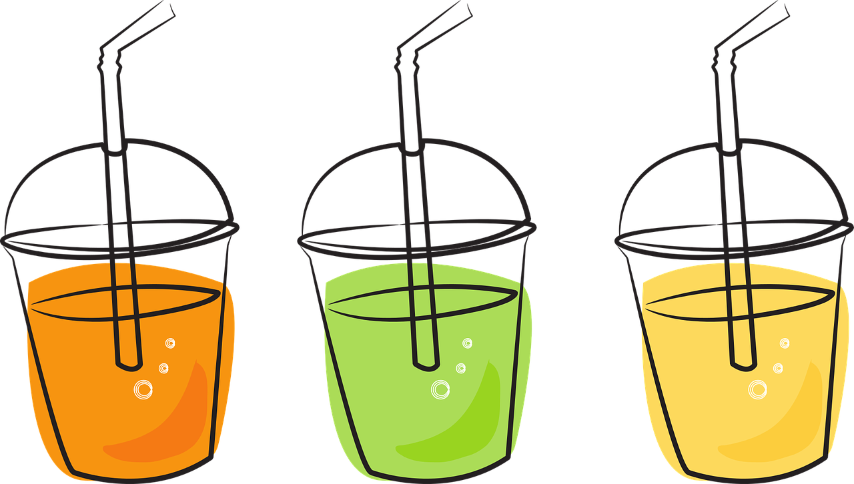

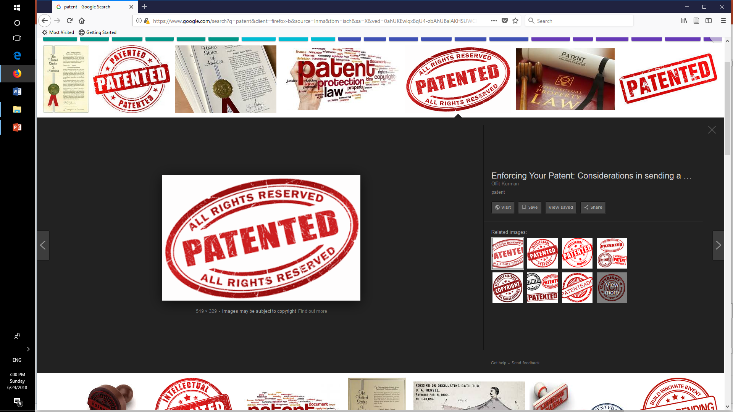


Outlook
Method elaboration for detection
of other sorts of beverages
Shape & size optimization
Marketing & commercializing opportunities
Built-in programming
Attractive design

Slide 20
References
[1] Alicyclobacillus spp. Control in the Fruit Juice Industry
[2] Microbiology of soft drinks and fruit juices (P. Wareing and R.R.) Davenport
[3] http://dairyprocessinghandbook.com/chapter/chemistry-milk
[4] Shinde Kajal P. et al IoT based detection of microbial activity in raw milk by using Intel Galileo Gen II in IRJET, india, 2017.
[5] Sung-Yueh Wu et al. 3D-printed microelectronics for integrated circuitry and passive wireless sensors in Microsystems & Nanoengineering, USA,2015
Fig.6.
[a] https://grabcad.com/library/circuit-board-pcb-mock-example
[b] https://grabcad.com/library/agian-glass-1

Slide 21

Thanks for your attention!

